Slide 1
Which pipeline components are right for you?

Slide 2
VCS
Version Control Systems helps software teams keep track of modifications of source code for their application
If a mistake is made, developers can go back to an earlier version of the code and use that to fix current mistakes
Key:
Branching/Merging
Traceability

Slide 3
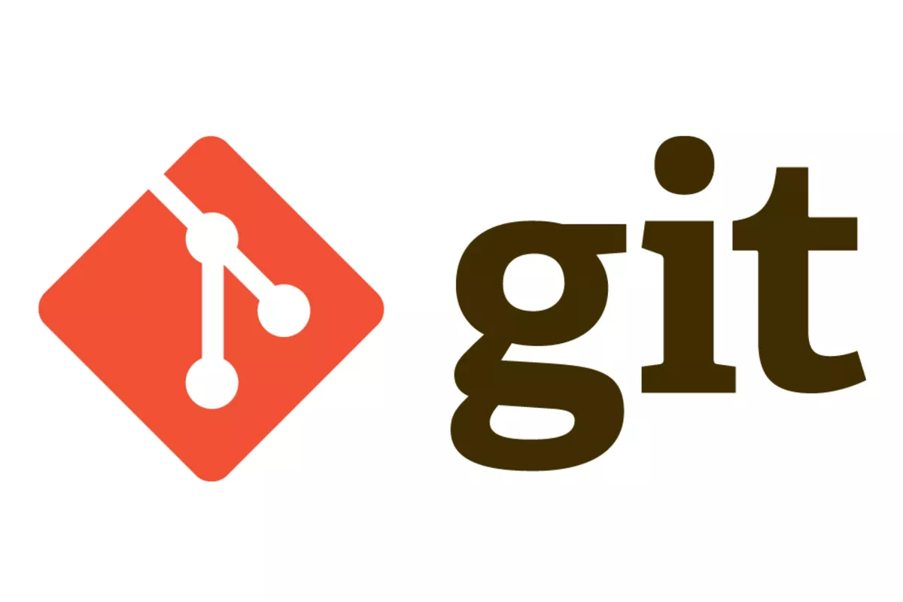
Git
Free, Open Source
Widely recognised, Industry standard
Benefits:
Collaboration with other developers easier with its branching and merging system
To start work, developers have to first create a unique branch.
Each branch functions in an isolated environment while changes are carried out in the codebase.
This ensures that the master branch always supports production-quality code.
Git support several kinds of nonlinear development workflows and its efficient in handling both small scale and large scale projects
Staging area - choose which files to commit to the repo next

Slide 4
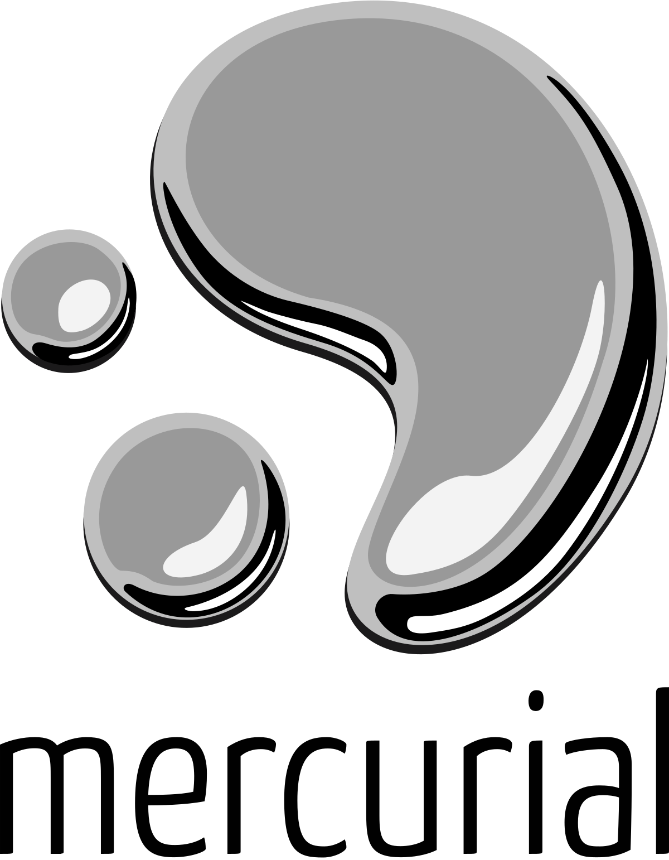
Mercurial
Free, Open Source VCS
Similar to Git
Has a distributed model - this means that that there is a repository on every computer and there is usually an "Official" repository that developers will choose to commit their changes to and pull from.
Generally for small projects
Benefits:
Easy to learn compared to Git
Better UI
Has a command which allows you to “undo” the last commit

Slide 5
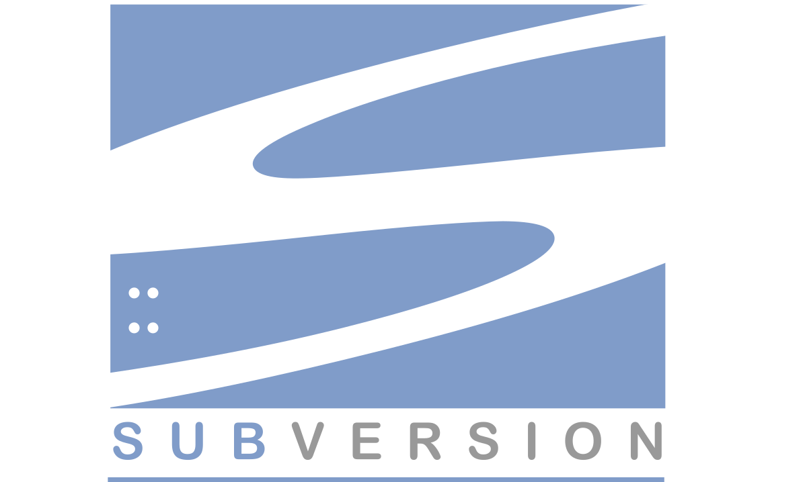
Subversion
Free, Open Source
Centralised Client/Server Version Control System - this means that all files and historical data are stored on a central server. And developers commit their changes directly to that central server repository.
Benefits:
Allows you to specify read/write access control per file level and directory level
Can handle large binary files which take up less space compared to git and mercurial.
On a client/server

Slide 6
Asana
Pros
Free plan perfect for small teams
Third party software integration (Slack, Dropbox, Google calendar)
Easily prioritise by breaking down tasks
Storage security
Dashboard customisation enabling seperate tracking of tasks
Allows invitation and assignment to a workspace

Slide 7
Asana
Cons
Not new user friendly, steep learning curve, training for full utilisation needed
Abundance of features can overwhelming for small teams/projects
Tasks can only be assigned to one individual
Cannot track time spent on each task
Limited exporting, no PDF or Excel formats

Slide 8
Trello
Trello
Free
Compatible with any size screen
Natural and simple UI
All items on one page
Creating issues and assignment to them is easy
Adding new users is easy via email invites
Very fast real-time updates

Slide 9
Trello
Cons
No Gantt chart to track project schedule or relationships between tasks
Only simple descriptions about boards allowed, no documents or wiki
No calendar
Tasks are limited to only one Board/Project
Difficult to work with multiple tasks in the UI, moving, copy paste
Limited number of labels

Slide 10
Jira
Pros
Powerful and flexible
Quick and intuitive UI, keyboard shortcuts and easy drag & drop
Customisable workflows
Lots of features
Gantt charts
Time tracking
JIRA Query Language autocomplete

Slide 11
Jira
Cons
Max cloud storage of 2 GB for free version
Can be complex/overwhelming
Difficult to setup
Search function is not good

Slide 12
Project Management
Choose Jira
Generous offer with most of the system’s features available for free (up to 10 users)
Offers kanban style boards like Trello
Gantt charts showing schedule and task dependencies very helpful for project management
Time tracking
Premium features include: anonymous access, audit logs, 99% uptime SLA (= 52m36s yearly downtime) and greater levels of support (only community support with free version) and storage

Slide 13
Continuous Integration (CI) Servers
CI is a process to remove build cycle inefficiencies through compilation of team code from version control repository (VCR)
Repository hosting service- cloud for code
CI servers
Jenkins
TeamCity
Github
Notes:
Automates testing- set up system to run unit tests/integration tests automatically
Monitors commits-

Slide 14
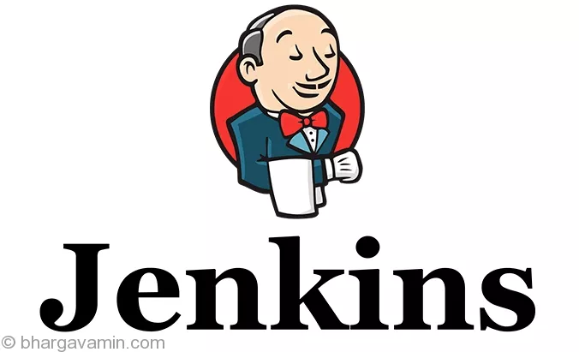
Jenkins
Supports Git, Docker, Amazon EC2 and S3
Cross-platform
Real-time testing and reporting
Provides large number of plugins
High customization
Self-hosting- in charge of server and environment
Notes:
Is open source- FREE!
•Written in java
Automate project/time-consuming tasks
Works with any programming language

Slide 15
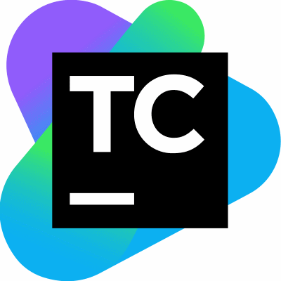
TeamCity
Automatic framework and configuration
Utilises cloud computing through integration with Amazon EC2, Microsoft Azure and VMware vSphere
Backs up and stores changes, failures and builds
Performs code coverage, code analysis, avoids code duplication etc
Notes:
Written in java

Slide 16
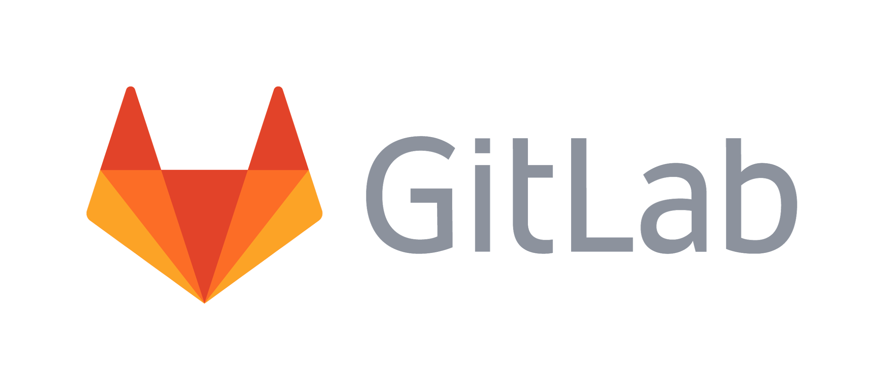
GitLab CI
Single dashboard
CMD build scripts- program in any languages
Scalable
Pre-built packages for Linux distributions
Fast installation, friendly UI, detailed documentation
Rollback capabilities
Notes:
Open source
Integrated into GitLab workflow
(Hosts Jenkin’s source code)??

Slide 17

CI Server Recommendation
The recommended CI Server- Jenkins
The benefits:
Custom plugins-Automate project/time-consuming tasks
Plugins- extends and modify with ease
Pre-built packages for Unix, Windows and OS X- easy installation and configuration
Has a large community
Is used by leading software brands

Slide 18
Build Automation Tools
What are build automation tools?
Converts files into a product
What have Build Automation Tools ever done for us?
Needed for effective CI
Less chances for defects
Ensures the target environment has been defined

Slide 19

Make
First build automation tool
Very basic
Fairly simple
Outdated and does not cater to current needs

Slide 20
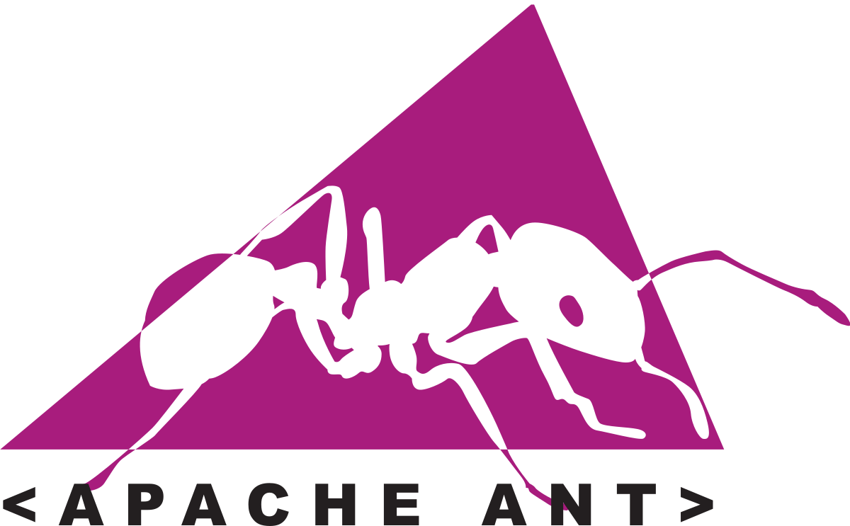
Ant
Easy to use
Even easier to learn to use
Uses XML
Is hierarchical
Unmanageable with larger projects
Comes with Apache Ivy
Allows for complete control of the build process
Notes:
Apache Ivy is a dependency manager: extension for managing external libraries during the development process, giving you a way of adding them to your classpath, bundling them into your application build, etc.
There's some overlap with what Maven does, but Ivy is much more lightweight (and doesn't do as much).

Slide 21
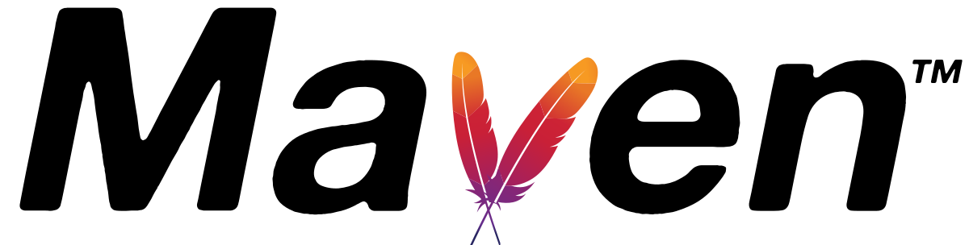
Maven
Improvement on Ant: uses XML with a different structure
Maps dependencies of files
Will last throughout the lifecycle of a project
Supports integration with many IDEs
Less flexible
Can cause clashes between dependencies

Slide 22
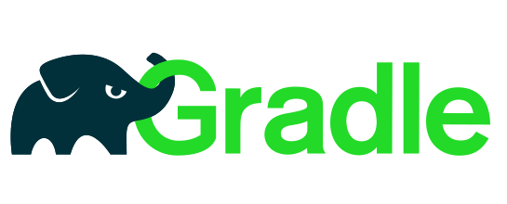
Gradle
Uses DSL (Domain Specific Languages)
Flexible
Designed for large projects
Especially popular for mobile apps: Android build system
Steep learning curve
Allows for the implementation wide range of features/tools

Slide 23
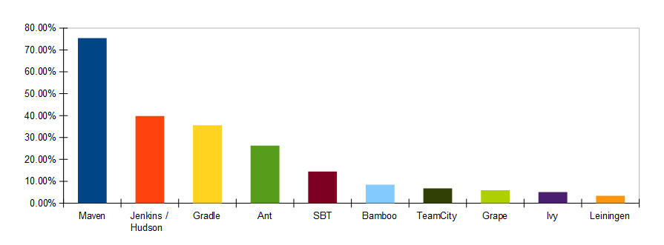
Which to choose?
All are free!!!
75% of Devs used Maven in 2017
Maven is faster/more reliable than Gradle
Maven is more intuitive
Maven more suited to a medium scaled project

Slide 24
Cloud
On demand computer resources without direct management from the user
Provide multiple services to build, test and deploy software
Remote access

Slide 25

AWS (Amazon Web Service)
Most experienced
12-months free
Wide range of services
Global availability
Pricing strategy
Steep learning curve
A lot of features

Slide 26
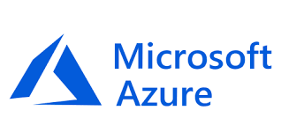
Microsoft Azure
Cheaper relative to other cloud providers
12-months free plus £150 free credit
Integration with Microsoft software and services
Good for Hybrid solutions
Mostly geared to Windows
More suited to large enterprises
Greater management required

Slide 27
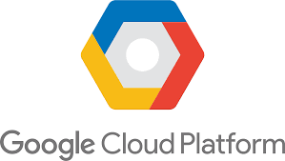
GCP (Google Cloud Platform)
Open-source and portability centric
Fast response times and load balancing
12 months free plus $300 credit (£233.07)
Flexibility on prices
Lack of features
Lack of data centres
Lack of experience

Slide 28
Questions?

Slide 29
